Slide 1
Programming / Electronics
The Art of talking to Computers

Slide 2
Today’s Plan - Friday
Programming and connecting the Arduino Microcontroller
Arduino overview
Learn to connect and upload programs to the controller
Arduino inputs and outputs
Track 1: C programming introduction
Track 2: Signal processing, multiple measurements, debugging options
Projects introduction
Lunch
Logger shield and real time clock
Sensors
Introduction to sensors
Measuring light, pressure, temperature, humidity, button trigger
Play with sensors
Projects definition development
Dinner
Observing

Slide 3
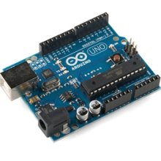
Arduino Microcontroller
Single – board microcontroller
CPU: 16MHz 32KB Flash, 1KB EEPROM
USB / Serial computer connection
Multiple analog and digital inputs and outputs
On-board power regulator
C-based programming language.
Notes:
Wide use: Help and examples available (more tomorrow)

Slide 4
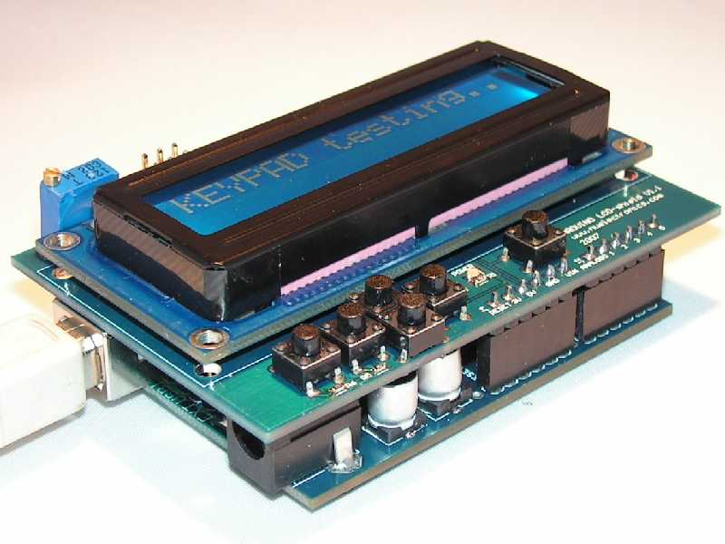
Why Use Arduino
Arduinos are Cheap - $25-30
Powerful but easy to learn. Rugged design tolerates errors.
Open source design and software
Large selection of compatible boards and shields
Many free libraries and add-on programs
Wide user base of scientists, engineers, hobbyists and educators
Help is available online
Examples are published to connect almost any piece of hardware to an Arduino
Numerous sample projects for free downloading
Notes:
SHOW: compatible board, other board formats, shields

Slide 5
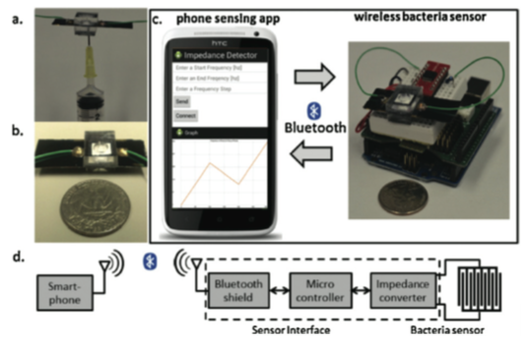
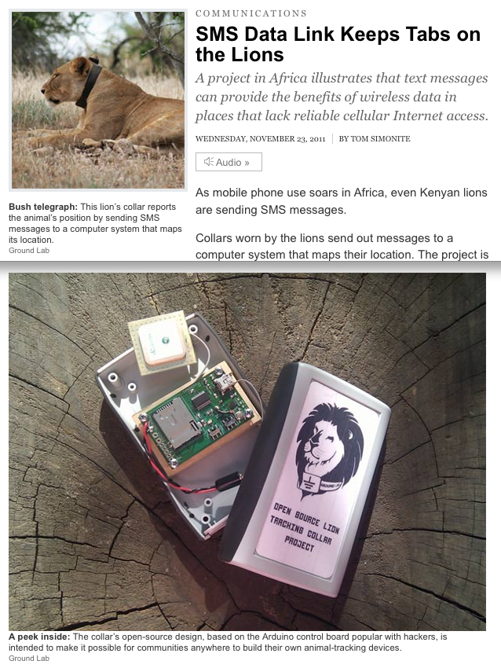
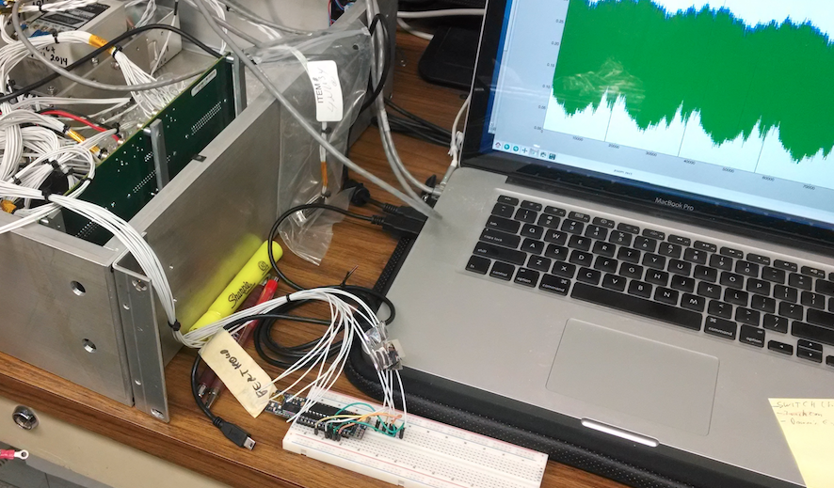
Arduino Examples

Slide 6
Let’s Code!
Connect the Arduino to your computer with the USB cable.
Start the Arduino program
Run the Blink example program
Go to File → Examples → 01. Basics → Blink
Upload the program to the Arduino. Check settings under Tools → Board and Tools → Port.
Option: Connect an LED with 220Ω resistor to pin 13.
Challenge: Change blink frequency
Challenge: Make advanced blink pattern
Run the AnalogReadSerial example program
Go to File → Examples → 01. Basics → AnalogReadSerial
Upload the program to the Arduino.
Open the Serial Monitor (under Tools), get voltages from GND, 3.3V, 5V
Option: Connect a variable resistor to GND and 5V to generate any input
Notes:
Talk about Arduino Program

Slide 7
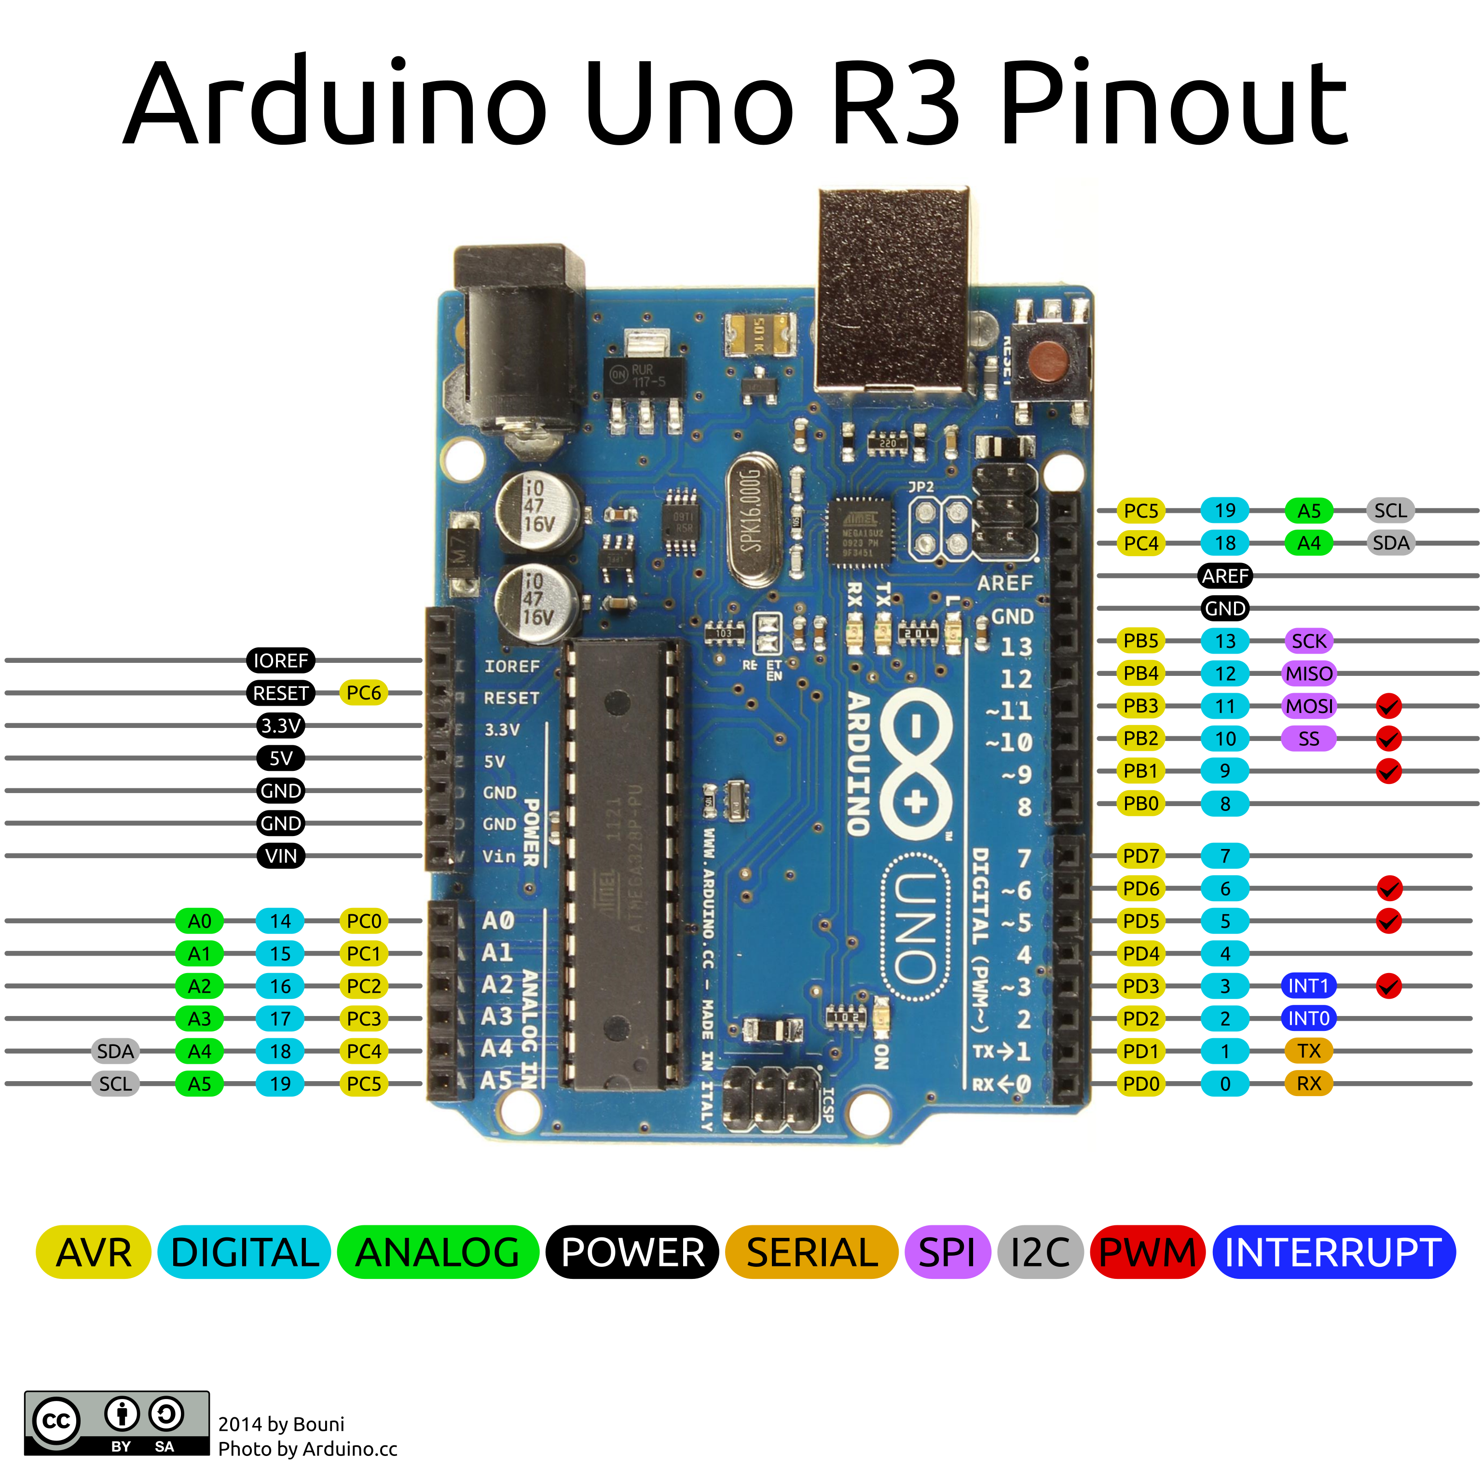
Connections
Digital Pins 0-19: Can be OUTPUT / INPUT / INPUT_PULLUP
Analog Input: Read 0-5V with 0-1023 resolution.
Analog Output (PWM at 500Hz): Generate square wave signal with appropriate duty cycle
Serial: Pins 0, 1 for serial communication (also USB)
Other pins can be used by software
Power: GND, 3.3V, 5V, VIN (i.e. the power on the barrel plug) and Reset
SPI and I2C: Pins for serial communication (other pins can be used)

Slide 8
Code Examples
In the Arduino Program under File→Examples
01 Basics → Fade: Uses analog output to fade light
01 Basics → ReadAnalogVoltage: Contains voltage conversion.
02 Digital → toneMelody: Uses array to store a melody
03 Analog → Smoothing: Stores values in array for averaged output
03 Analog → Fading: Fading with for loop.
Yerkes examples: Download them at stars.uchicago.edu/public/BuildYourOwn/Arduino/Printouts
Dark count: Counts number of seconds darkness is detected
RGB_LED: Cycles through colors with RGB LED. Includes function declaration.

Slide 9
Coding Topics
Statistics (avg, stdev ( ) , median) lowpass filter now = f * old + (1-f) * new
States: counters / instrument mode
Vectors and Matrices: int array[2] = {0, 1}
Functions: int square(int x) { return x*x; }
Eeprom: permanent data storage
Timing: delay, millis
Objects for utilities: display, temp sensor
Notes:
I

Slide 10
Projects Introduction / Lunch Break

Slide 11
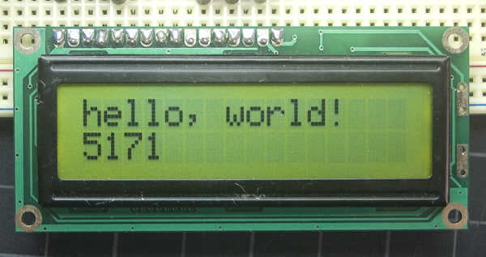
Data Logger Shield
Contains a real time clock (RTC) and SD card reader.
Run through the adafruit tutorial at learn.adafruit.com/adafruit-data-logger-shield
Run through the sections
Overview
Shield overview
Downloads – to install the SC and RTC libraries on your computer.
Using the Real Time Clock
Using the SD Card
Other useful tool: LCD display
Allows display of values and results at runtime.
Uses quite a few pins
Takes time to code

Slide 12
Sensors
Basic Types
Analog: Measure resistance, voltage or time interval. Simpler to use but may need calibration and noise handling
Digital: Communicate with Arduino using digital protocols (1-Wire, I2C or SPI). Have built-in microcontroller that communicates with external electronics (i.e. Arduino).
Calibration: May be required by all sensors for adequate results.
Example: Temperature sensor offset adjustment with ice water

Slide 13
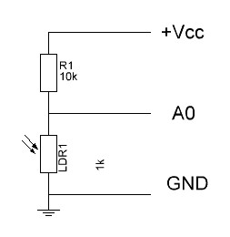
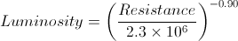
Analog Sensors
Resistor Sensor
Measure with voltage divider
Reference resistor determines range, see XL
Requires calculation to get measured value.
Examples: Gas sensors, luminosity
Voltage Sensor
Generates voltage related to measured value
Examples: 3-axis accelerometer, TMP36
T(C) = 100^{C}/_{V} (V_{in} – 0.5V)
Notes:
XL: Describe math, plot, basic, idea, issues and consequences

Slide 14
Available Sensors
Sensors in your Package: Follow the link below for description of all your sensors. www.sunfounder.com/37-modules-sensor-kit-v2-0-for-arduino-1130.html
CdS photoresistor: Resistive light sensor
RHT03 Temperature & Humidity Sensor: Digital readout, 1-Wire protocol.
BMP180 Barometric Pressure / Temperature / Altitude Sensor: Digital I2C protocol
Other sensors for experiments:
TMP36 Temperature Sensor: Voltage output proportional to temperature.
DS18B20 Waterproof Temp Sensor: Digital readout, 1-Wire
LV EZ3 Ultrasonic Range Finder: Returns pulse duration, use pulseIn() function.
Gas sensors: Alcohol MQ-3, Methane MQ-4, CO MQ-7, Hydrogen MQ-8. Measure resistance with given voltage.
MMA7361 Triple Axis accelerometer: Analog voltage readout for each axis.
Motion Detector
Radio sender / receiver 434MHz: Simple sender and receiver
RFM69 Radio Transceiver 433MHz: Intelligent sender/receiver microcontroller.
Interface:
Dynagraph.py

Slide 15
Let’s do Sensors
For each sensor in your package, run the basic tutorial program online.
You might have to install additional libraries, see www.arduino.cc/en/Guide/Libraries for details.
Select and test one of the other sensors.

Slide 16
Today’s Plan - Saturday
Project Development
Development tools
Best practices
Online help
Data Analysis with Excel and iPython
Project Work
Lunch – George Williams
Yerkes Tour
Project Work – Yerkes Library and FabLab
Project Presentations – Yerkes Library

Slide 17





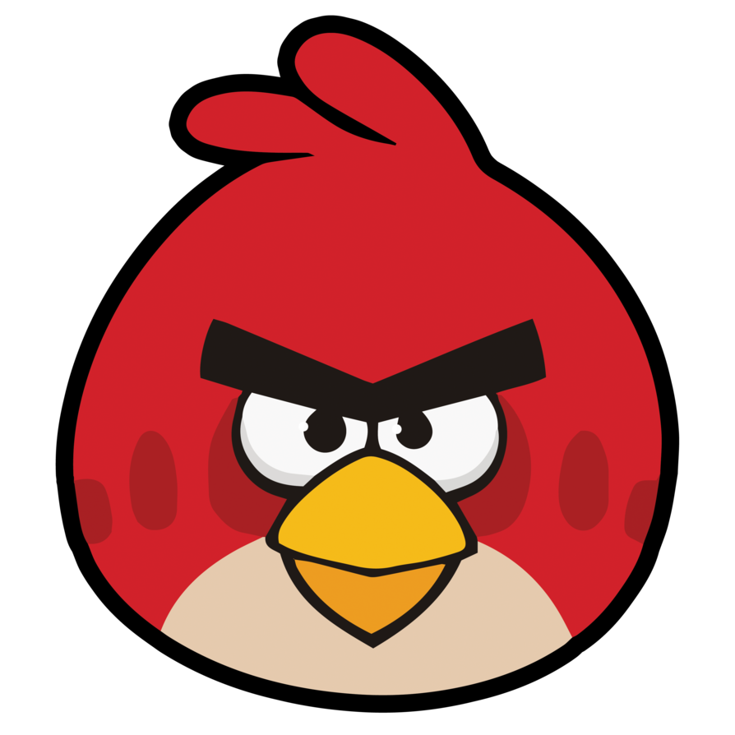






Programming Today (2010s)
Compilers and Interpreters advanced and reliable
Support libraries available for (almost) any purpose
Communication, Graphics, Numerical Simulations
Support: Forums , Maillists, Live Chat
Business Models:
Free and Open Source
Freeware / Shareware
Commercial
Notes:
Open Source: Anyone can change. People helpful b/c want recognition and pride in product.
Free/Shareware: Profit, Past open source, Service

Slide 18
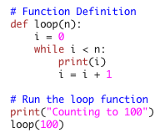
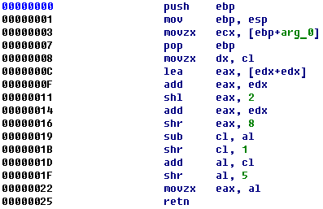
Programming
Program Code vs Machine Language
Computer run machine language (assembler)
Two ways to run a code on a computer:
Interpreter: Executes program code.
Compiler: Creates executable file (machine language) from program code

Slide 19
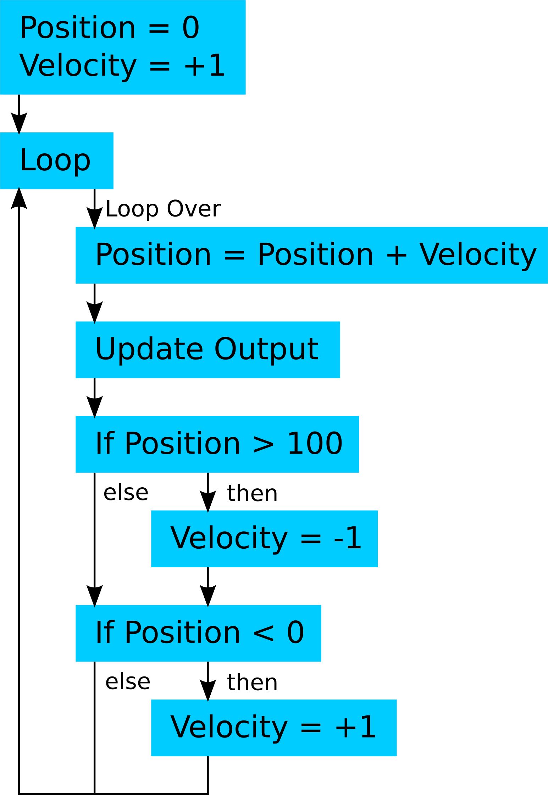
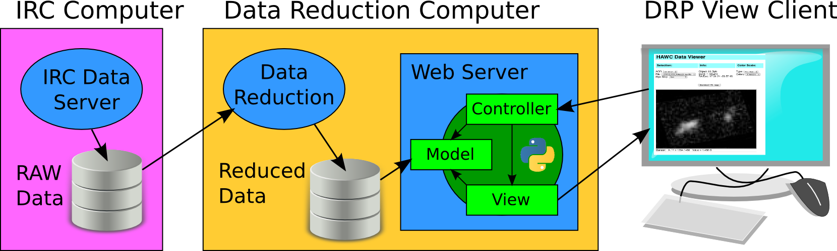
Code Development
Tools:
Development: Flow, Physical, Case, State Diagrams
Content management
Integrated Development Environment (IDE)
Notes:
Give examples for Case, State Diagrams
Show Github page

Slide 20

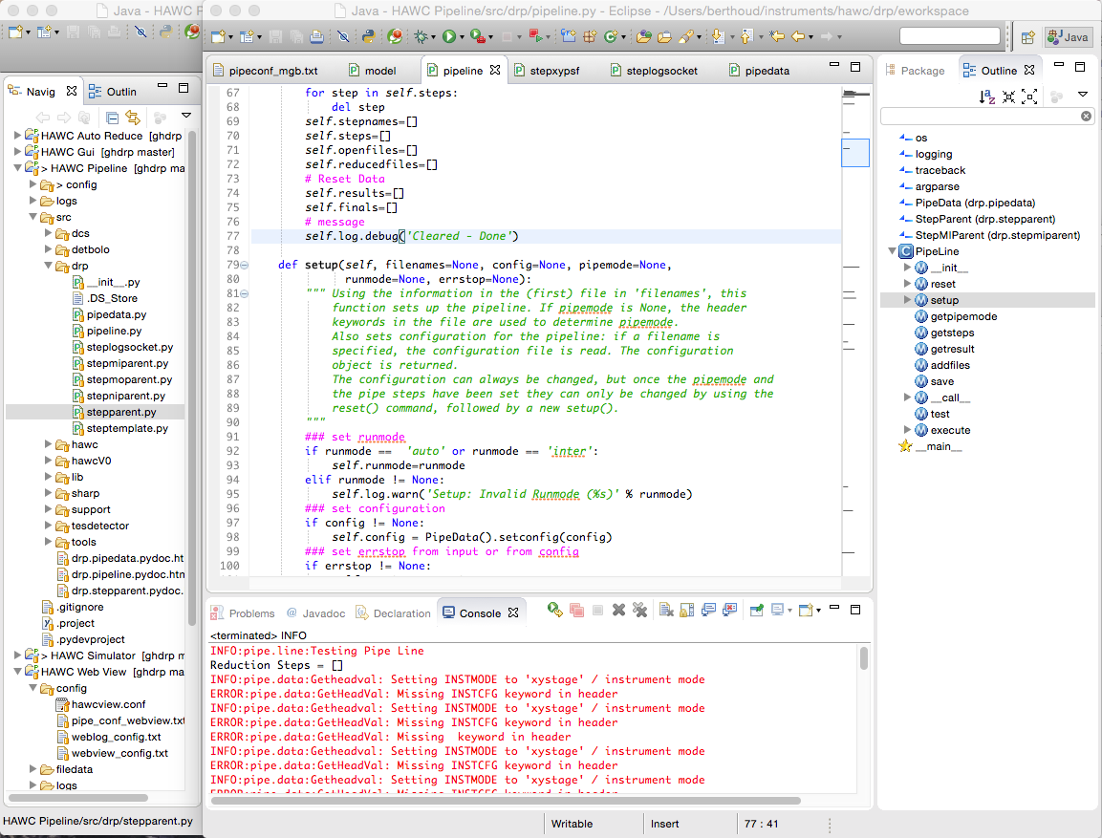
IDE Example:

Slide 21
Best Practices - Programming
DOCUMENT:
Header: What does this code do, How to use this program, What needs to be connected, Who wrote / modified it, When and What was added/changed
Inline
Useful variable names: short, unambiguous, descriptive Ex: pinTemp3
What does the following part of the code do. Describe functions. Ex: // Read temperature sensor to tempVal // Store result in file
Details about individual expressions tempVal = ( 5.0 * tempVal / 1023 – 0.5 ) * 100 ; // Convert counts to celsius
Development process: Why was this implemented in this way – may be published on a wiki / blog
Why document: Your students will be gone in 2-4 years, you don’t want new students to reinvent the wheel
Notes:
----- Meeting Notes (7/23/16 09:51) -----
Documentation: Add throughts that you have when the code was written. Also log what didn't work.

Slide 22
Best Practices – Programming cont.
Readability:
Indentation: Keep it consistent (2-4 spaces). Also keep lines < ~80 characters.
Empty lines: Before each function, between significant blocks for long functions
Modularity: Keep functions short – make separate functions. Keep programs short – make libraries.
Libraries (or functions) can be reused in other projects
Look for existing code
Likely someone already wrote something you can use. Copy but give credit.
Make sure you only copy what you need
Keep older versions – use version control

Slide 23
Best Practices – Electronics
Lab Practices:
Wear safety glasses
Don’t rewire powered devices
Check connections before powering up
If in doubt consult manuals / reference material
Deployment:
Test EVERYTHING at least twice before actual deployment.
Includes: final program, electronics, power source, housing
Many bugs only show up in fully integrated systems
Documentation: Use fritzing for making schematics, breadboard and PCB layouts: fritzing.org/home
Notes:
Demonstrate Fritzing
----- Meeting Notes (7/23/16 10:07) -----
Companies makes boards for ~$5. Eagle is also good

Slide 24
Online Documentation
Arduino:
www.arduino.cc: main Arduino page, contains tutorials, reference material and information on connecting additional tools.
Tutorials / Howto:
stackexchange.com: User driven Q&A page for almost all your programming / electronics question. Usually tops your google results.
www.instructables.com: includes tutorials for using arduino.
hackaday.com: Many DIY ideas, several including arduino.
edwardmallon.wordpress.com: Blog on building Arduino-based loggers for environmental monitoring. Many good links.
Suppliers: Most sell Arduinos and other compatible electronics.
adafruit.com: Also has good tutorials / learning site.
sparkfun.com: Has many interesting parts – also more mundane ones

Slide 25
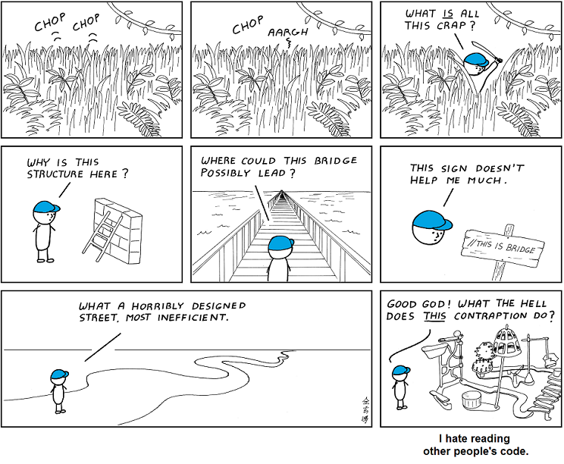
Make Good Code

Slide 26
Data Analysis
Data Storage
Text File with tab-separated values: Universally readable (excel, python, editor)
Add column headers (with units if possible)
Standardize filenames.
Tip: Include date as (YY)YY-MM-DD in filenames (Month names don’t sort gracefully)
Avoid spaces in filenames
Analysis tools: How to make nice plots
Spreadsheet: Open Office, Google Docs, Excel
Interpreted program: Python, Matlab,
Online tools: plot.ly or other

Slide 27
Make some Plots
Get Yerkes Telescope Environment data from stars.uchicago.edu/public/DataLogs
Format is Date, Time, Floor Height (in), Brightness (Lux), Temperature (C), Humidity (%)
Link to sensor system at stars.uchicago.edu/telescopes/yerkes24/Yerkes24Env.html
Can you plot yesterday night’s data?
Open your favorite data analysis tool
Import the data
Crop the data
Plot it

